Slide 1
Architecting Safety using Cybersecurity Requirements and Assessments
Don C. Weber - @cutaway
Principal Consultant, Founder
© 2024 Cutaway Security, LLC. All Rights Reserved.

Slide 2



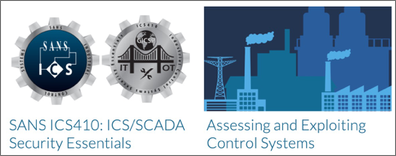
Cutaway Security, LLC / Don C. Weber
Masters Degree in Information Assurance
IACS Security Program Maturity
IACS Security Assessments
Penetration Testing
Security Research

Slide 3



Agenda
The Cybersecurity Safety Challenge
Starting the Architecture Conversation
Starting the Assessment Conversation
Summary
Questions (possibly afterwards)

Slide 4


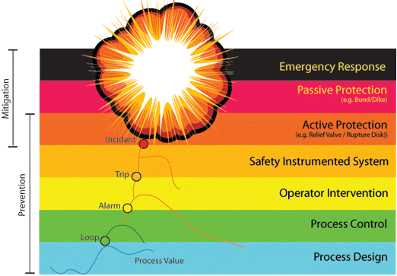
Safety and Protection Systems
ICS410 | ICS/SCADA Security Essentials
Safety and protection systems
Prevents worse-case scenarios
Great lines of last defense
Implemented in your most critical processes
Requires full manual reset after triggered
Failures: https://www.csb.gov/videos/
SIS systems include automated protection:
Leak detection equipment
Tank/sump alarms
Hazardous gas detectors
Burner management
Nuclear safety detection systems
Source: SANS ICS410 | ICS/SCADA Security Essentials
Notes:
A SIS is engineered to perform specific control functions to failsafe or maintain the safe operation of a process when unacceptable or dangerous conditions occur. SISs must be independent of all other control systems that control the same equipment in order to ensure SIS functionality is not compromised. A SIS is composed of the same types of control elements as any other control system; however, all of the control elements in a SIS are dedicated solely to the proper functioning of the SIS.
The specific control functions performed by a SIS are called Safety Instrumented Functions (SIFs). They are implemented as part of an overall risk reduction strategy that is intended to eliminate the likelihood of a previously identified SH&E event that could range from minor equipment damage up to an event involving an uncontrolled catastrophic release of energy and/or materials. A safe state is a process condition, whether the process is operating or shut down, such that a hazardous SH&E event cannot occur. The safe state must be achieved in a timely manner or within the "process safety time".
A SIS must have sensors capable of detecting abnormal operating conditions. A logic solver is required to receive the sensor input signals, make appropriate decisions based on the nature of the signals, and change its outputs according to user-defined logic. The logic solver can use electrical, electronic, or programmable electronic equipment, such as relays, trip amplifiers, or programmable logic controllers. Next, the change of the logic solver outputs results in the final elements taking action on the process to bring it to a safe state. Support systems, such as power, instrument air, and communications are generally required for SIS operation. The support systems should be designed to provide the required integrity and reliability.
International standard IEC 61511 was published in 2003 to provide guidance to end users about the application of Safety Instrumented Systems in process industries. This standard is based on IEC 61508, a generic standard for design, construction, and operation of electrical, electronic, and programmable electronic systems. Other industry sectors can also have standards that are based on IEC 61508, such as IEC 62061 (for machinery systems), IEC 62425 (for railway signaling systems), IEC 61513 (for nuclear systems), and ISO 26262 (for road vehicles). ISO 26262 is currently a draft international standard.

Slide 5
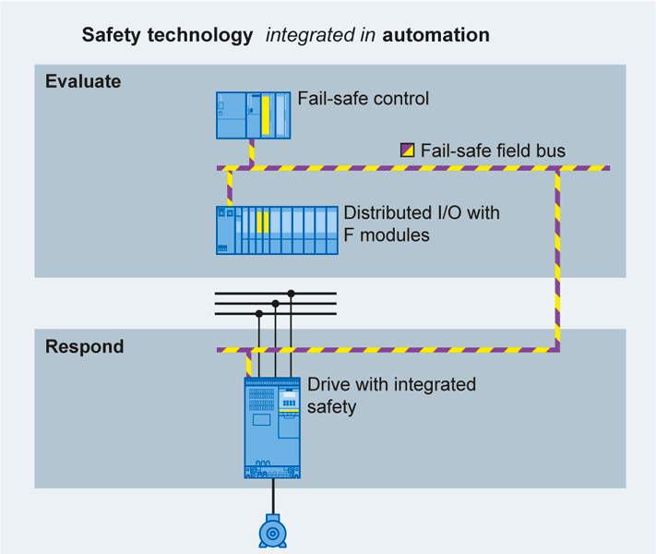
Traditional Safety System vs. Integrated Safety System
ICS410 | ICS/SCADA Security Essentials
Benefits of integration:
No additional hardware
Reduced wiring
Short response times
Simplified proof of safety
Source: SANS ICS410 | ICS/SCADA Security Essentials
Notes:
"The safety circuit used to have its own set of logic around the machine and equipment. The movement of integrated safety is bringing safety right into the devices and equipment," Craig Nelson, product marketing manager at Siemens Industry US, told DesignNews. "Everything is on the same system now. It becomes a lot more economical, with more safety, more diagnostics, increased productivity, more functionality. We couldn't do that the traditional way."
"A lot of it comes down to the economics. The company is protecting its reputation. They want the higher level of safety that comes with integrated safety," Nelson said. "It's more economical to put safety in, and it's more economical to maintain safety."
Reference:
DesignNews – “Integrated Safety Breaks the Cost-Savings Barrier at Plants”
https://goo.gl/fro2KS

Slide 6

The Cybersecurity Safety Challenge
Safety is traditionally NOT considered a cybersecurity task
PHA/HAZOP, FEMA, and LOPA are process safety evaluation techniques
ISA/IEC 62443 initial and detailed risk assessments meet these criteria, separately
Vendors / integrators deploy and maintain
Consider example of rides at amusement parks where responsibility-lines with owner/operator blur
Safety equipment *might* be air-gapped
Consider consequence prioritization if / when assets are connected to a network
International standards, by sector, are trying to catch up
Consider ISA TR 84.00.09, Cybersecurity Related to the Functional Safety Lifecycle (approved April 10, 2017)
Consider ISO/TR 22100-4 “Safety of machinery – Relationship with ISO 12100 – Part 4: Guidance to machinery manufacturers for consideration of related IT-security (cyber security) aspects”
ASTM F24 Cybersecurity for Safety-Related Controls Task Group
Image Source: AI generated on MidJourney on March 13, 2024

Slide 7
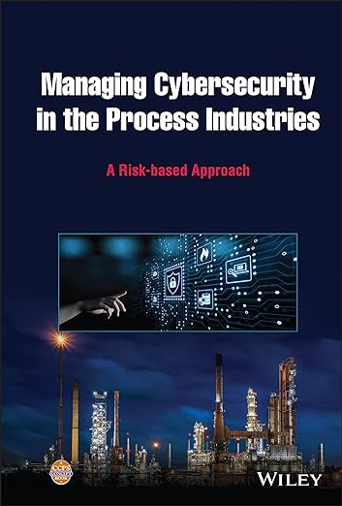
They Wrote a Book About This*
* I just bought it and started reading it
Managing Cybersecurity in the Process Industries: A Risk-based Approach
By: Center for Chemical Process Safety
https://www.amazon.com/Managing-Cybersecurity-Process-Industries-Risk-based/dp/1119861780
However, cybersecurity driven common cause failures have the potential to occur even more frequently, because they are the result of an intentional action taken by an attacker.

Slide 8

Starting the Architecture Conversation
ISA/IEC 62443
Reference Models
Reference Architecture
Zone / Conduit Models
Risk Assessment Methodology
Detailed Risk Assessment
Image Source: AI generated on MidJourney on March 13, 2024

Slide 9
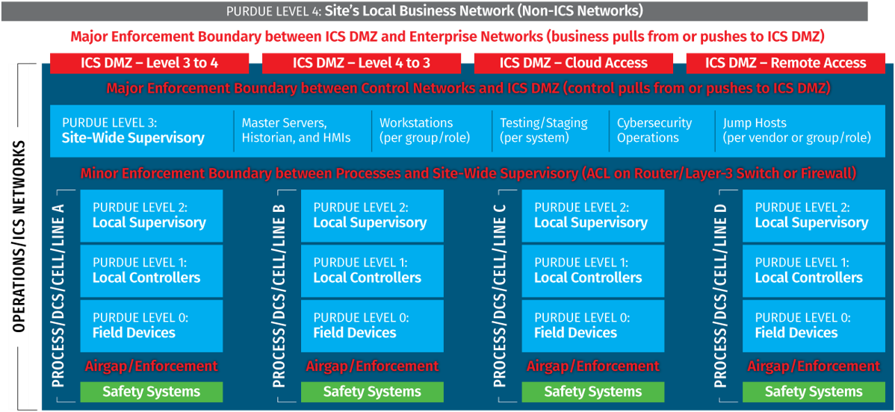
Reference Models
Reference Models establish a frame of reference for more detailed information about the IACS environment.
NOTE: The SANS ICS410 Reference Model is based on the ISA/IEC 62443 standards

Slide 10
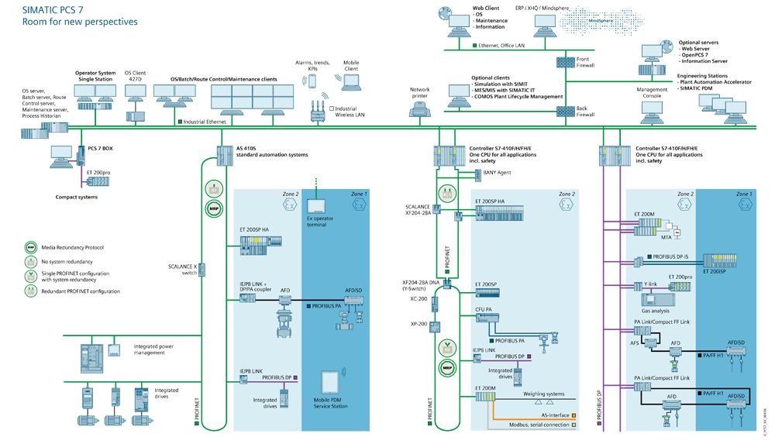
Reference Architectures
Reference Architecture are diagrams that describe the physical and logical deployment of assets of an organization, location, or scope of evaluation.
Image Source: Siemens architecture SIMATIC PCS7: https://www.automation.siemens.com/bilddb/download.aspx?reqInsID=1502504

Slide 11
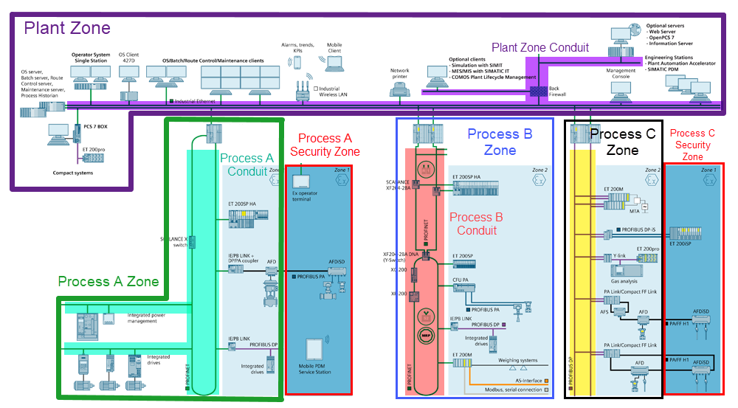
Zone / Conduit Model
Zone / Conduit Models are logical groups of assets, typically nested, that define characteristics and communications of the assets which can be used to analyze security requirements.

Slide 12
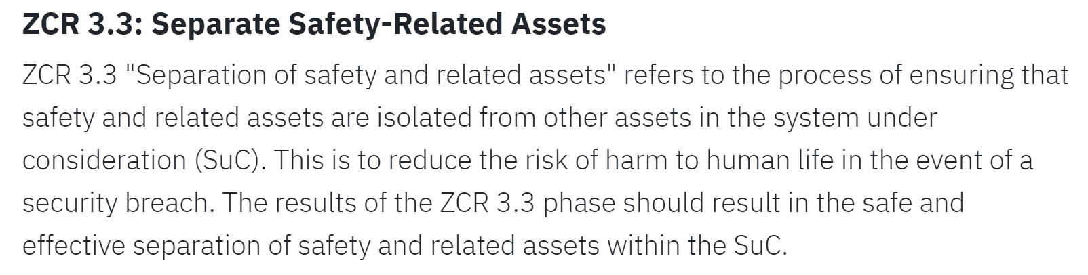
ISA/IEC 62443-3-2 ZCR 3.3: Separate safety related assets
Image Source: https://novesh.com/blog/novesh-blog-7/understanding-iec-62443-3-2-zones-conduits-and-risk-assessments-27

Slide 13
ISA TR 84.00.09, Cybersecurity Related to the Functional Safety Lifecycle
Cyber Security Assessments (CSA) should be carried out that the following stages of a System-Under-Consideration's (SUC's) lifecycle:
Stage 1: After the detailed risk assessment, countermeasure selection, and CSRS for the SUC has been developed to ensure the conceptual design reduces risk appropriately.
Stage 2: After the IACS cybersecurity countermeasures have been integrated into project's conceptual design prior to construction, aka Cybersecurity Factory Acceptance Testing (CFAT).
Stage 3: As a part of the Pre-Startup Safety Review (PSSR), aka Cybersecurity Site Acceptance Testing, to ensure the SUC is safe and secure for operations.
Stage 4: Periodic or reactive activities during normal operations and maintenance of the SUC.
Stage 5: As a part of change management and decommissioning of the SUC.
Two concerns drive cybersecurity safety considerations:
Safety function failure to perform when needed
Spurious operation that cause unauthorized activation, cause business interruption, or damage equipment
Physical safety considerations that are a part of the risk assessment process but not a part of the cybersecurity assessment consideration, for example:
Safety controls not vulnerable to cyberattack
Other than validating they are not
Hard wired interlock systems
Pressure relief valves
Check valves

Slide 14
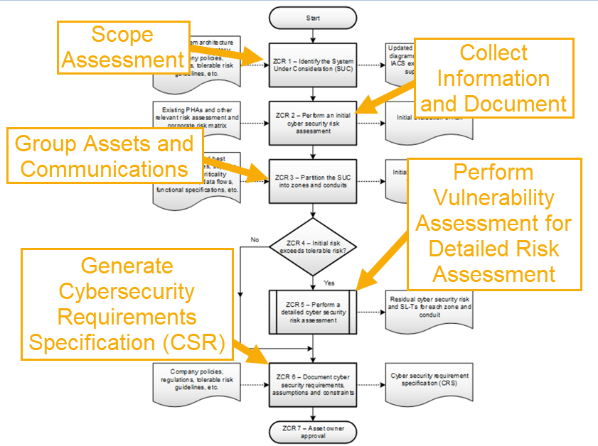
Risk Assessment Methodology
Defined in ISA/IEC 62443-3-2
High-Level Risk Assessment
Collects information about System Under Consideration (SUC)
Organizes SUC into Zones and Conduits
Completes documentation of SUC
Detailed Risk Assessment
Vulnerability assessment of SUC’s zones and conduits
Details unmitigated risk and countermeasures effectiveness to compare SL-A to SL-T
Provides actionable intelligence to produce CSRs
Image Source: White Paper Excerpt: Leveraging ISA 62443-3-2 For IACS Risk Assessment and Risk Related Strategies : https://gca.isa.org/blog/white-paper-excerpt-leveraging-isa-62443-3-2-for-iacs-risk-assessment-and-risk-related-strategies

Slide 15
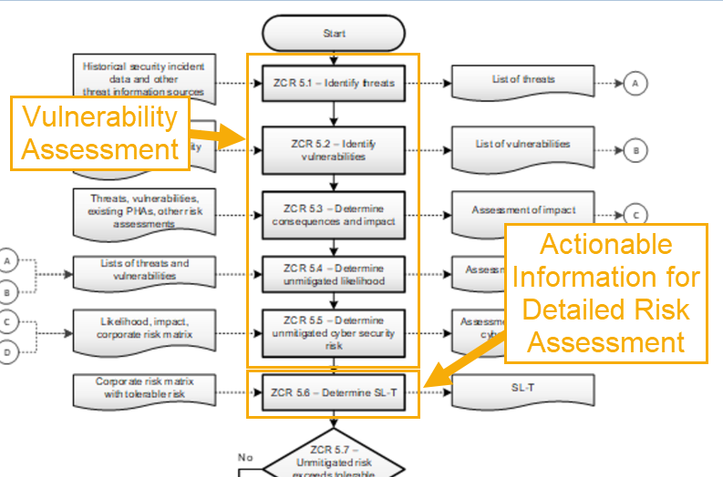
Detailed Risk Assessment
Defined in ISA/IEC 62443-3-2
Detailed Risk Assessment
Vulnerability Assessment
Security Assessment
Penetration Test
Compare Achieved Security Level (SL-A) to Target Security Level (SL-T)
Compare Residual Risk to Tolerable Risk
Identify and apply appropriate countermeasures
Document and Communicate
Image Source: White Paper Excerpt: Leveraging ISA 62443-3-2 For IACS Risk Assessment and Risk Related Strategies : https://gca.isa.org/blog/white-paper-excerpt-leveraging-isa-62443-3-2-for-iacs-risk-assessment-and-risk-related-strategies

Slide 16
Starting the Assessment Conversation
SUC Assessment Information
ISA/IEC 62443 Foundational Requirements
SANS ICS Five Critical Controls
Image Source: AI generated on MidJourney on March 13, 2024

Slide 17
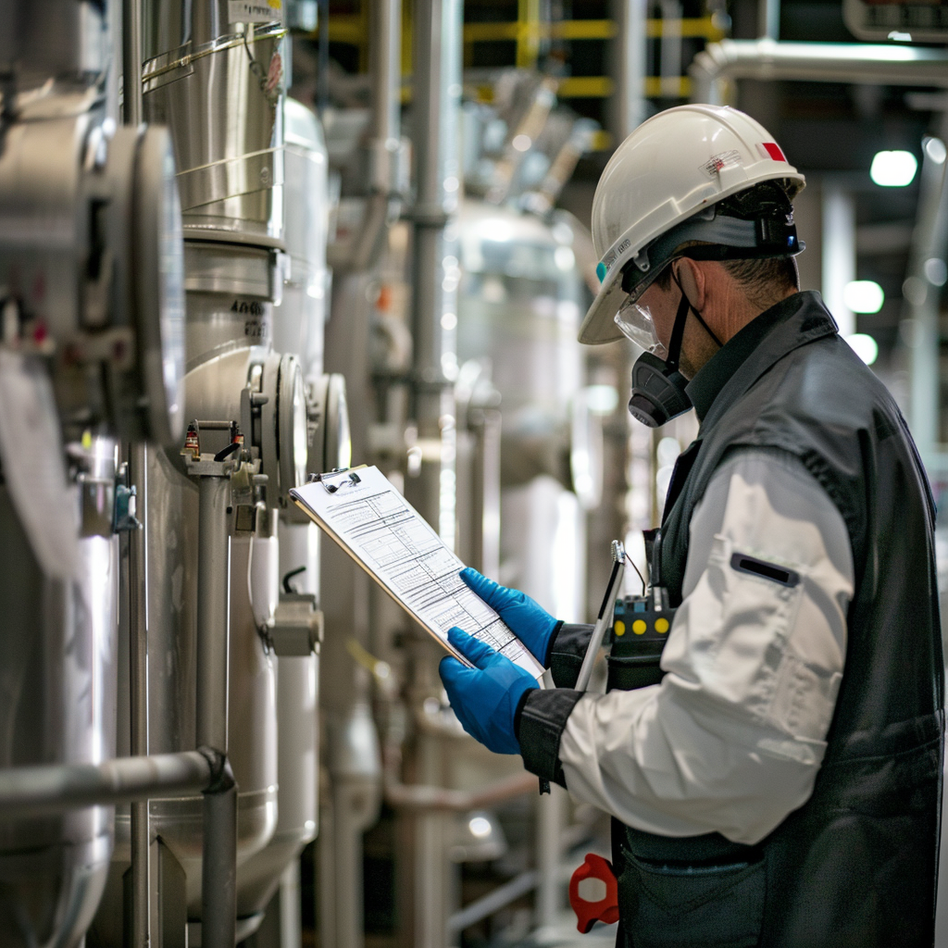
SUC Assessment Information
System Under Consideration (SUC)
Name / Unique Identifier
Identify Stakeholders
Process / Environment Description
Assessment Goals
Safety and Criticality Description
List of Technologies
List of Deliverables
Timeframes
Locations
Testing Constraints
Image Source: AI generated on MidJourney on March 13, 2024

Slide 18
ISA/IEC 62443 Seven Foundational Requirements
Identification and Authentication Control (IAC)
Use Control (UC)
System Integrity (SI)
Data Confidentiality (DC)
Restricted Data Flow (RDF)
Timely Response to Events (TRE)
Resource Availability (RA)
FR1
FR2
FR3
FR4
FR5
FR6
FR7

Slide 19
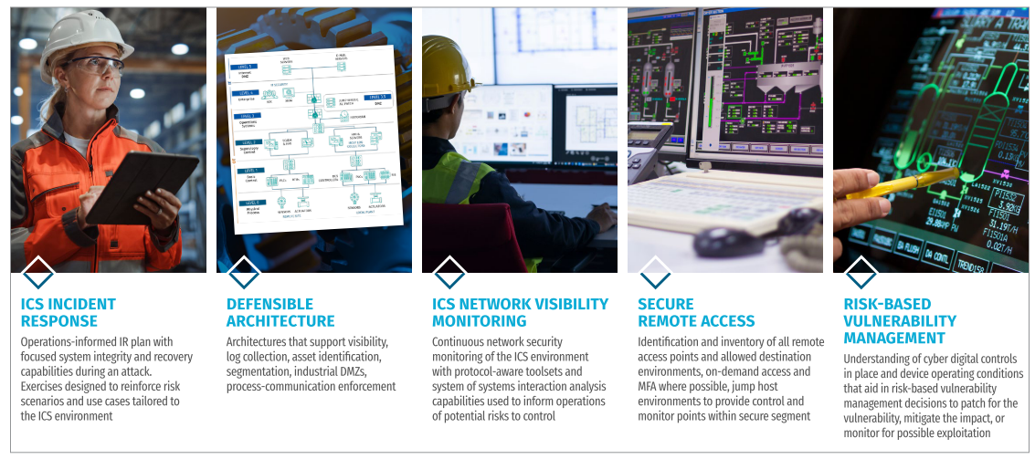
SANS ICS 5 Critical Controls for ICS Cybersecurity
Image Source: Five ICS Cybersecurity Critical Controls Whitepaper: https://www.sans.org/white-papers/five-ics-cybersecurity-critical-controls/

Slide 20

Safety Cybersecurity Assessment Focuses
Secure Remote Access
Third-Party
Employees
Cloud
Defensible Architecture
Network Segmentation / Isolation
Attack Surface
Communications
Risk-Based Vuln Management
Hardware / Software Asset Inventory
Configuration Management
CISA KEVs
ICS Network Monitoring
Countermeasure Efficacy Testing
ICS Incident Response
Does your team understand the consequences of any of these things?
Image Source: AI generated on MidJourney on March 13, 2024

Slide 21

Multipart Summary
Outsource Operations
Quick Start vs Cybersecurity Program
Incident Response
Image Source: AI generated on MidJourney on April 2, 2024

Slide 22

Outsourced Operations
Owners / Operators
YOU are ultimately responsible
You MUST require vendors / integrators provide you cybersecurity details
Vendors / Integrators
You MUST provide details about cybersecurity to owners / operators

Slide 23
Quick Start vs Cybersecurity Program
Both Require a High-Level Risk Assessment to define team and scope.
Future standards will require more of vendors, integrators, and owner / operators.

Slide 24

Incident Response
Physical segmentation is ideal, as you can air gap and not impede functionality of the SIS should a threat warrant that response.- Gavin Dilworth (zDHD)
You can island (i.e. remove remote access)
Prevention is ideal, but detection is a must; however, detection without response has minimal value. – SANS ICS410
Image Source: AI generated on MidJourney on April 2, 2024

Slide 25
Special Thank You To: Gavin Dilworth (zDHD) CutSec Discord Beer-ISAC Other OT/IT/Infosec Professionals

Slide 26
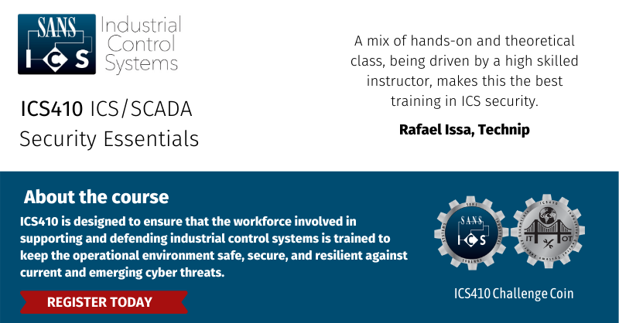
Don C. Weber - @cutaway info@cutawaysecurity.com https://www.cutawaysecurity.com https://www.linkedin.com/in/cutaway/ Cutaway Security Discord

